Slide 1


COMPOSER & LAUNCHER
L
Notes:
<a href="https://www.freepik.com/free-photos-vectors/business">Business vector created by freepik - www.freepik.com</a>

Slide 2

WHAT IS Data Platform?
Creates any application by composing business centric components like MBS with LOW CODE or NO CODE at all
Composer
L
Launches an application created by Composer
Launcher
Notes:
<a href="https://www.freepik.com/free-photos-vectors/mockup">Mockup vector created by freepik - www.freepik.com</a>

Slide 3
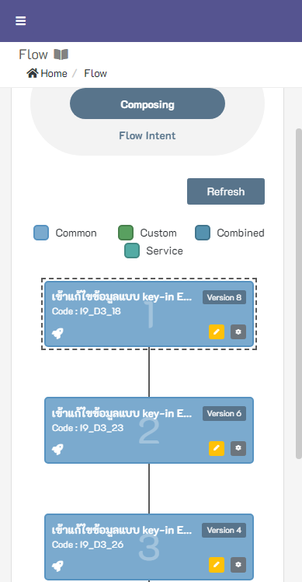
FUNCTIONS & FEATURES
Build Faster
Build an application with low code or no code at all by utilizing MBS and Components within the platform. Super users can even do it.
Shelf-ready Components
More than 1,000 MBS, More than 1,000 Business Rules, More than 1,000 Output Profiles and more that already are on-shelf and ready to be used.
Visualization
Visualize components as you build in a graphical context or visual data set setting as you see on the screen.
Instant Test / Feedback
Test your application right after you compose it. Instant test gives you an instant feedback about your configuration so you can adjust it to fit user's need.
Pre-made Business Activity
If on-shelf is not what you want, there are pre-made business activity (Standard Processes) that you can choose to go along with your data.
Customization
Business Scenes can be different from one business to another, you can adjust the standard MBS component to fit specific business scenes like Label, Sorting, Format, Require, Hint and many more.

Slide 4
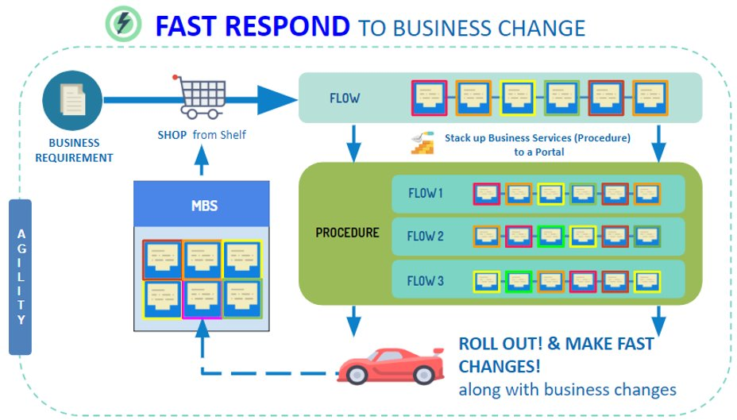
KEY BENEFITS
TIME TO MARKET
Thousands of MBS or other components that could be used for application building which can dramatically shorten time to market
RIGHT SECURITY
System complies security guidelines and went through many penetration testing
FAST RESPONSE
If business changes, business flows could be changed along with the business
EASE OF MAINTENANCE
Single Infrastructure for all the application
Notes:
<a href="https://www.freepik.com/free-photos-vectors/mockup">Mockup vector created by freepik - www.freepik.com</a>

Slide 5
ADOPTION RATES Supporting Back-web Application for these applications
25
Production
Car Plate Detector V7
Phoenix
Bankruptcy
My Protection
Digital Shelf - MBS (V7)
CSR Somwang V7
Lead Monitoring
(OWN) Consent Management & Data Subject Right V7
e-KYC & Customer Onboarding V7
And more...

Slide 6
IMPROVEMENT
UX/UI
Performance
Governance
Core Feature
Users
Revise User Experiences / User Interface
Display Preference
Builder
Improve builder's experiences with intuitive way to build
Easier way to setup components
Launcher Runtime Performance
Improve widget / standard processes
User Activity Traceability
Dashboards for different aspects
Change alert based on subscriptions
Multiple Dataset View / Entry
API as Common MBS
Automate Deployment
Platform Privacy
Platform Connector
Notes:
<a href="https://www.freepik.com/free-photos-vectors/mockup">Mockup vector created by freepik - www.freepik.com</a>

